Slide 1
Defensive Security Project
by: Brandon, Patrick, Matthew, Terrell, Corey, Evan

Slide 2
Table of Contents
This document contains the following resources:
Monitoring Environment
Attack Analysis
Project Summary & Future Mitigations

Slide 3

Monitoring Environment
‹#›

Slide 4
Scenario
We set up a series of monitors and alerts for a company named VSI.
A rival corporation launched an attack on VSI.
We monitored our windows activities such as user logins and attempted password resets
We monitored their apache web app, accounting for events such as location based access, HTTP methods used, and domains that referred user to the website.

Slide 5
Website Monitoring Add-On
‹#›

Slide 6
Website Monitoring
Monitors websites to detect downtime and performance problems.
Uptime Calculation:
-The Status History dashboard provides information about past failures and calculates the website's uptime percentage
Status Monitoring Dashboard:
-Provides the response time for your monitored websites and provides a historical analysis of the site's responsiveness
Email Outage Alerting: get an emailed alert when your website is not responding (responds too slowly or is returning an error)

Slide 7
Website Monitoring
JobeCorp, a rival of VSI, has a history of targeting competitors through Distributed Denial of Service (DDoS) attacks aimed at crippling their online platforms. We were tasked with utilizing the web monitoring add-on to oversee the availability and proper operation of VSI's web application.
-We established a Website Monitoring Input to oversee the status of VSI's web application: https://vsi-corporation.azurewebsites.net/. This monitoring occurs at 10-minute intervals, with a 30-second grace period before labeling a connection as failed.
-Following our investigation, it is evident that VSI's web application failed to respond. This leads us to deduce that JobeCorp has executed a proficient DDoS attack, effectively incapacitating the web application.
-We have created an alert to email SOC@VSI-company.com when the web application is not responding.

Slide 8
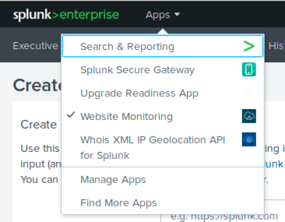
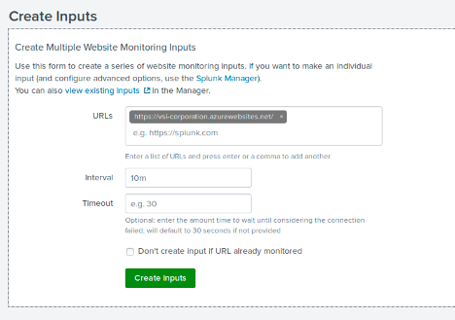
Website Monitoring Screenshots
Add-on Successfully in apps drop down
Input created

Slide 9
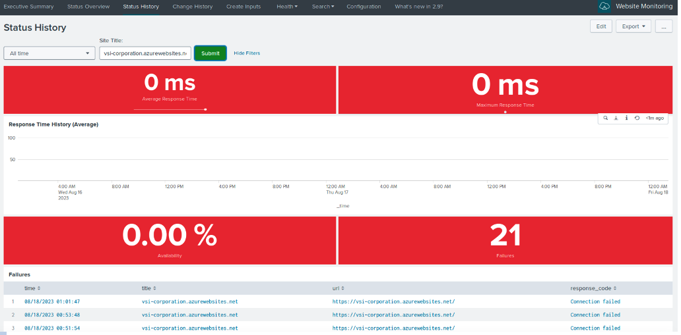
Website Monitoring Screenshots
The Status History

Slide 10
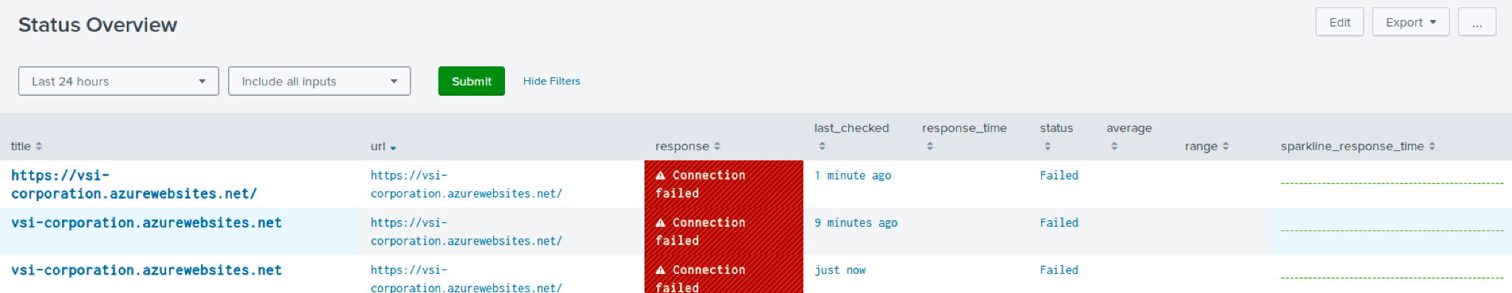
Website Monitoring Screenshots
The Status Monitoring Dashboard

Slide 11
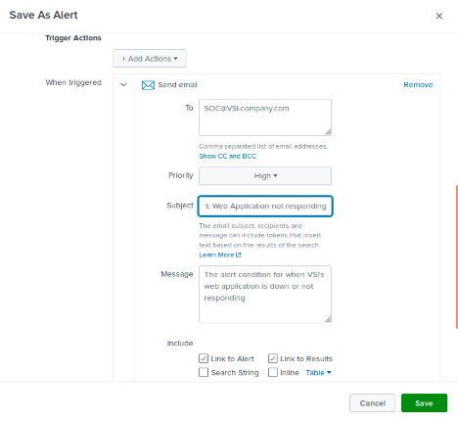
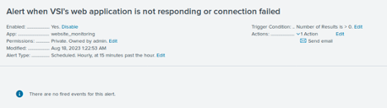
Website Monitoring Screenshots
Alert to send email when web application is not responding

Slide 12
Logs Analyzed
Windows Logs
Apache Logs
1
2
The windows logs contained various events within the windows environment. Such events included but not limited to login attempts, account lockouts, password change attempts, account deletion, and more.
The Apache logs contained various HTTP request events for the VSI web site. They were monitored for various subjects such as methods used, client locations, and domain referrals.

Slide 13
Windows Logs
‹#›

Slide 14
Reports—Windows
Designed the following reports:
Report Name | Report Description
Signature windows_server_logs | Signature and Signature IDS for windows_server_logs
Severity windows_server_logs | Severity levels with count and percentage for windows_server_logs
Activities windows_server_logs | A count of Successful and Failure window log activities in windows_server_logs

Slide 15
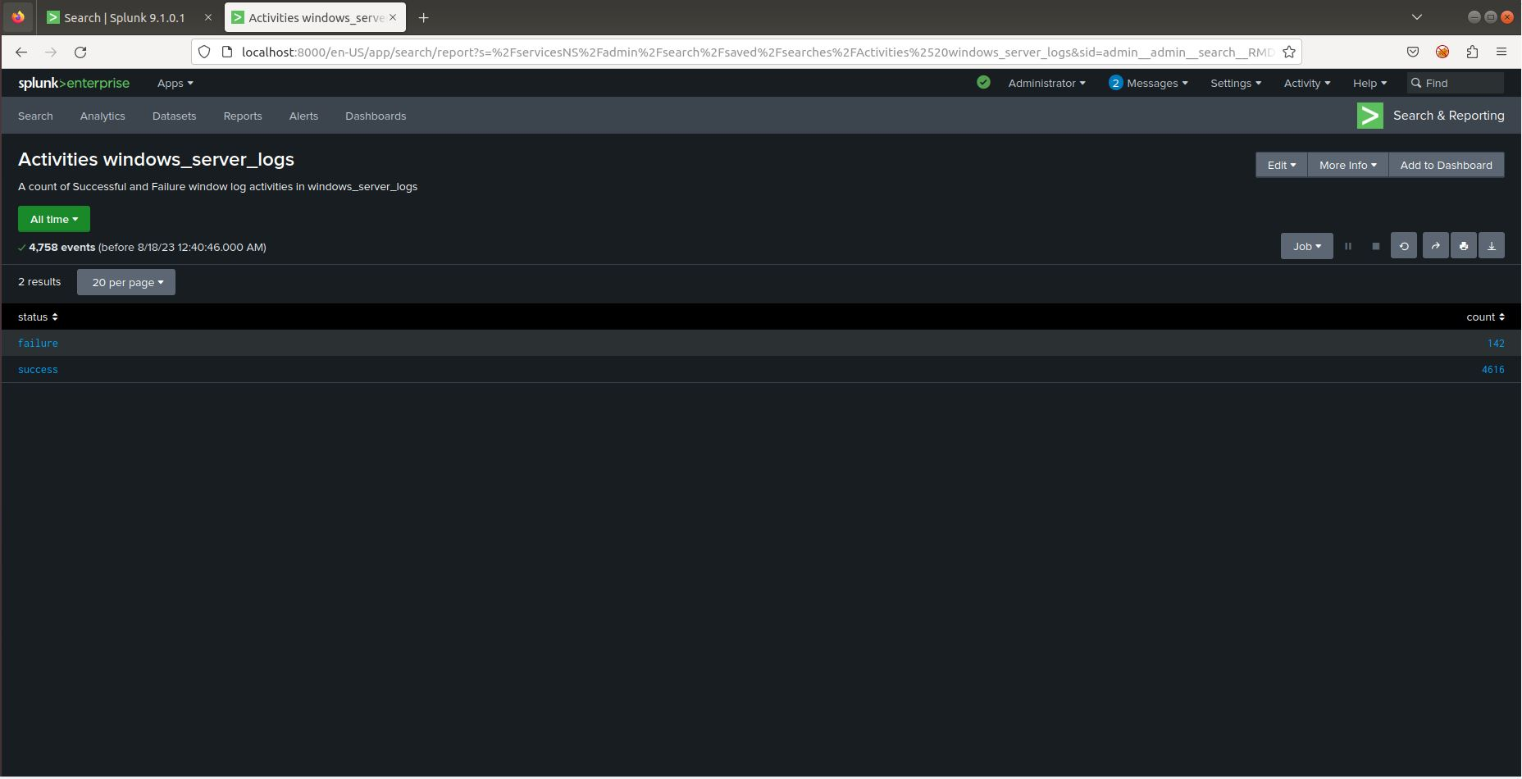
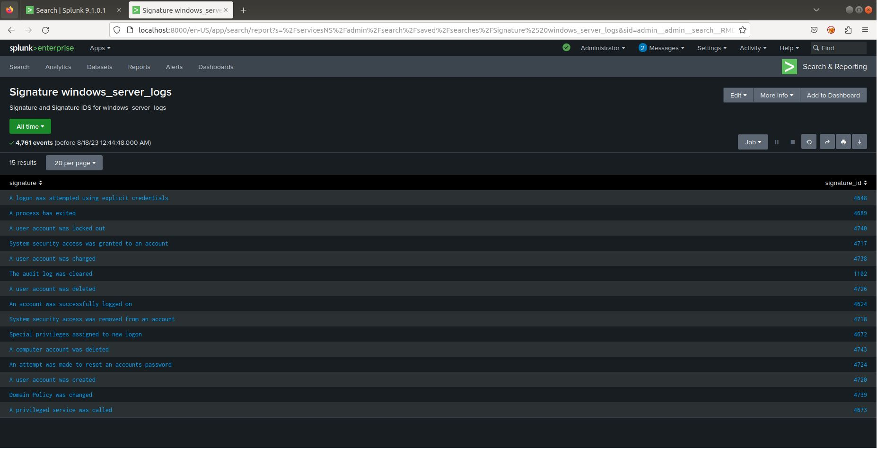
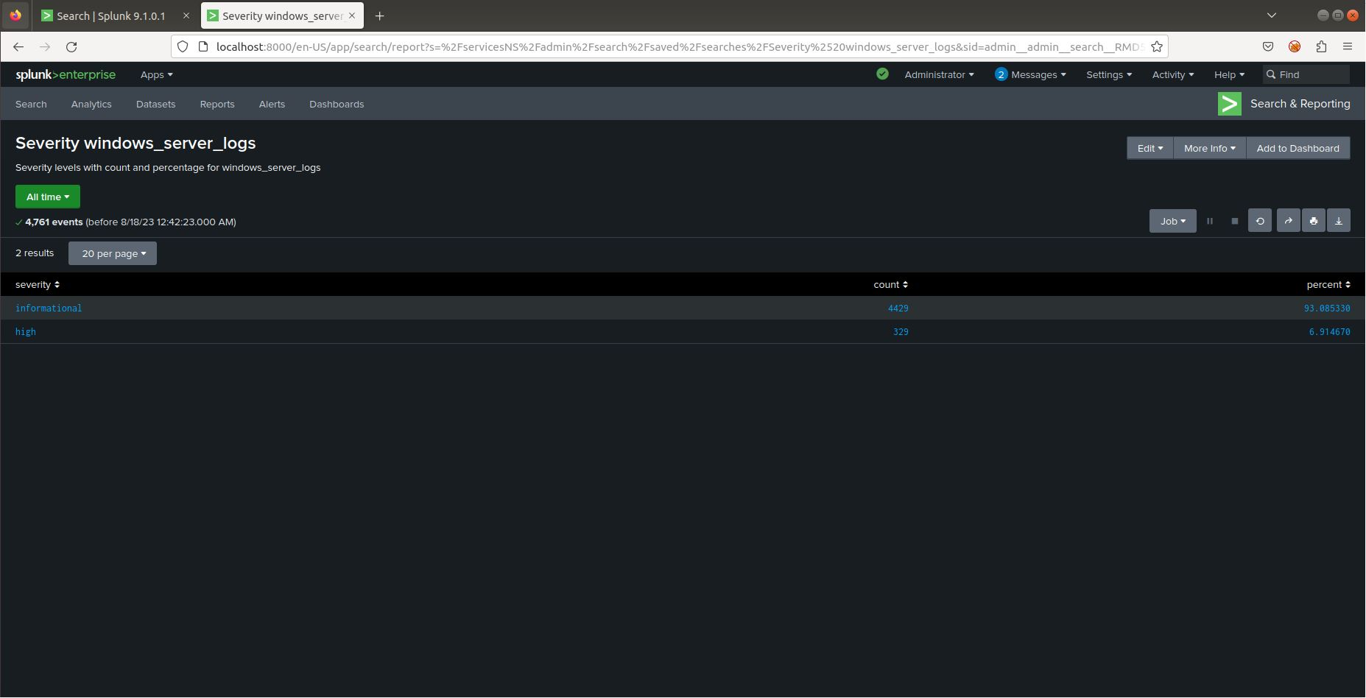
Images of Reports—Windows
Report Image
Report Image
Report Image
Report Image

Slide 16
Alerts—Windows
Designed the following alerts:
Alert Name | Alert Description | Alert Baseline | Alert Threshold
failed_windows_activities | The threshold for failed windows activities has been reached | 10 | 15
JUSTIFICATION: 10 failed windows activities per hour was the average amount of failed activities per hour so I set the baseline to 10. I set the threshold to 15 as more of the abnormal amount of failed activities reached around 15 per hour

Slide 17
Alerts—Windows
Designed the following alerts:
Alert Name | Alert Description | Alert Baseline | Alert Threshold
Successful Hourly log ins Alert | More than 30 successful hourly log ins | 25 | 30
JUSTIFICATION: I set my baseline to 25 as it was around the average amount of successful logins per hour and my threshold to 30 as the abnormal amount of successful logins per hour was around 30

Slide 18
Alerts—Windows
Designed the following alerts:
Alert Name | Alert Description | Alert Baseline | Alert Threshold
User account was deleted alert | More than 30 user accounts were deleted in an hour | 25 | 30
JUSTIFICATION: I set my baseline to 25 as it was around the average amount of deleted accounts per hour and my threshold to 30 as the abnormal amount of deleted accounts per hour was around 30

Slide 19
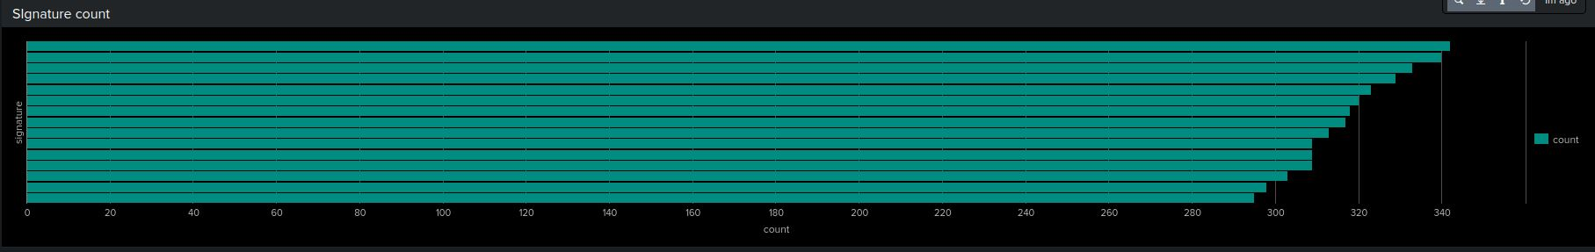
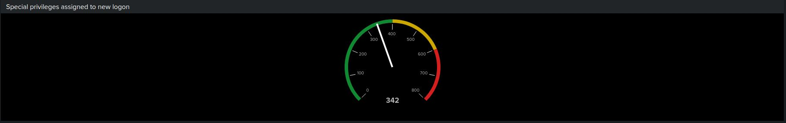
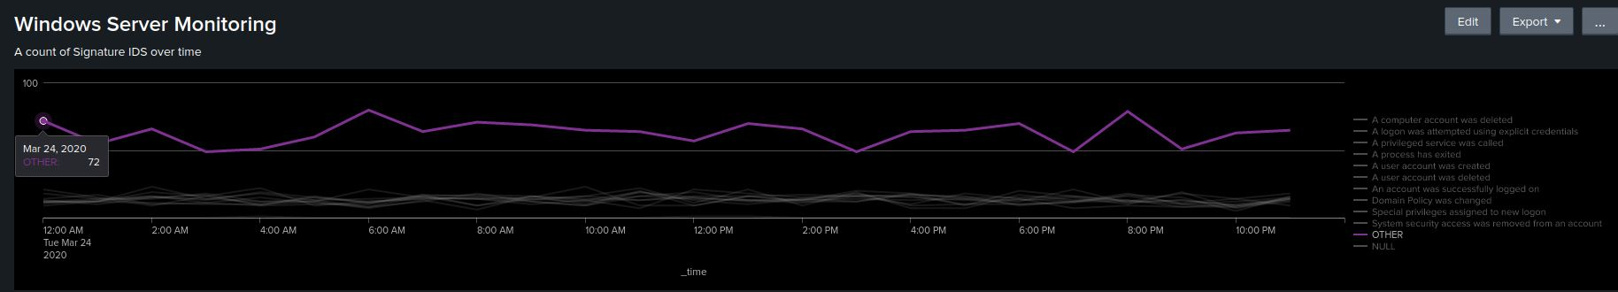
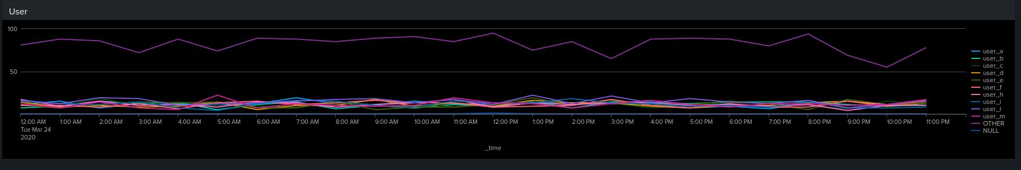
Dashboards—Windows
Place image here
Place image here
Place image here
Place image here

Slide 20
Dashboards—Windows
Place image here
Place image here
Place image here
Place image here

Slide 21
Apache Logs
‹#›

Slide 22
Reports—Apache
Designed the following reports:
Report Name | Report Description
Method count by hour | Tracks HTTP methods used
Geo location by hour | Tracks activity for specific regions
URI paths | Tracks top used URI paths
Referrer Domain | Tracks website paths to access VSI website

Slide 23
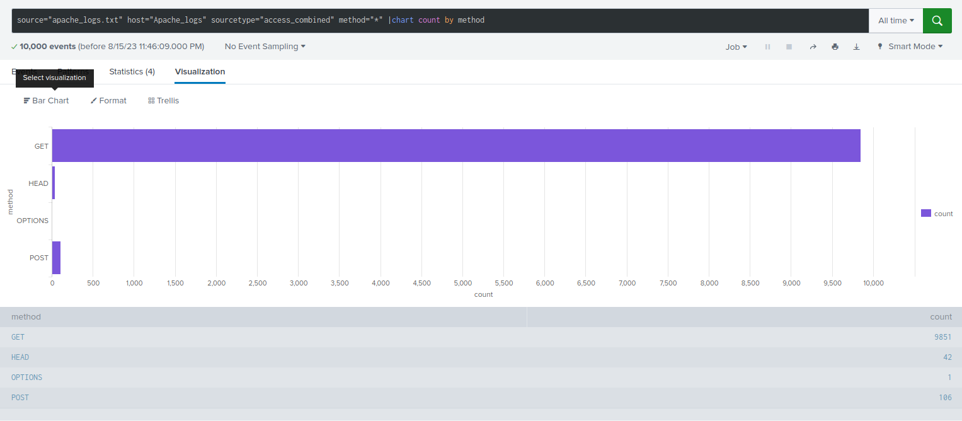
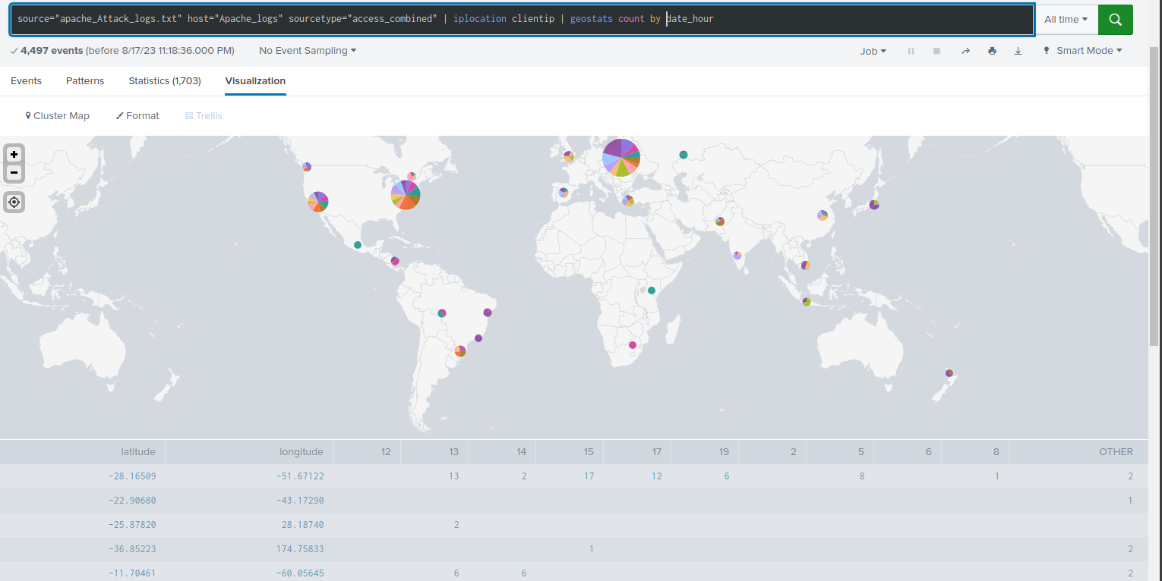
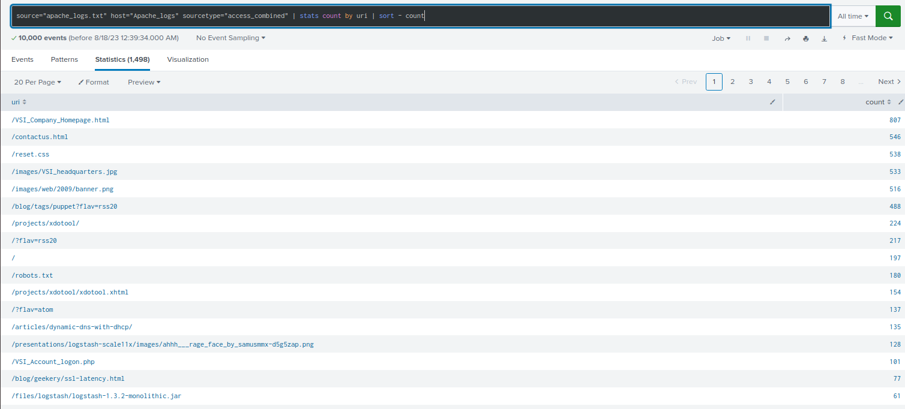
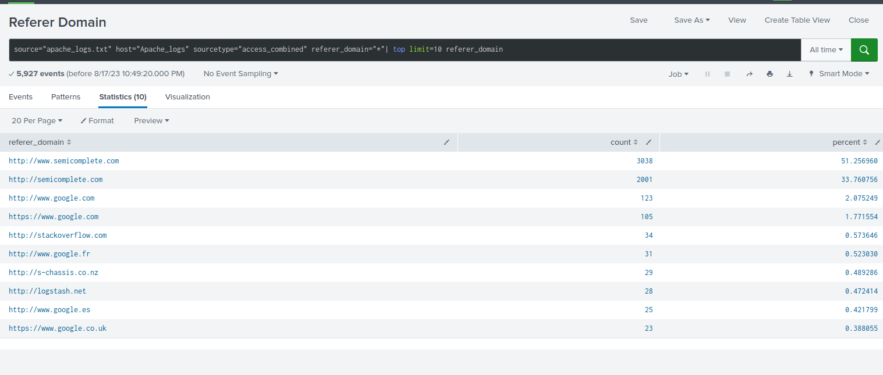
Images of Reports—Apache
Report Image
Report Image

Slide 24
Alerts—Apache
Designed the following alerts:
Alert Name | Alert Description | Alert Baseline | Alert Threshold
Post Activity | Abnormally high POST requests per hour. | 0 | 4
JUSTIFICATION: Posts average about 2 per hour with an outlier of 7.

Slide 25
Alerts—Apache
Designed the following alerts:
Alert Name | Alert Description | Alert Baseline | Alert Threshold
Foreign Activity | Abnormal activity of foreign countries per hour. | 75 | 120
JUSTIFICATION: Baseline would just be above average.

Slide 26
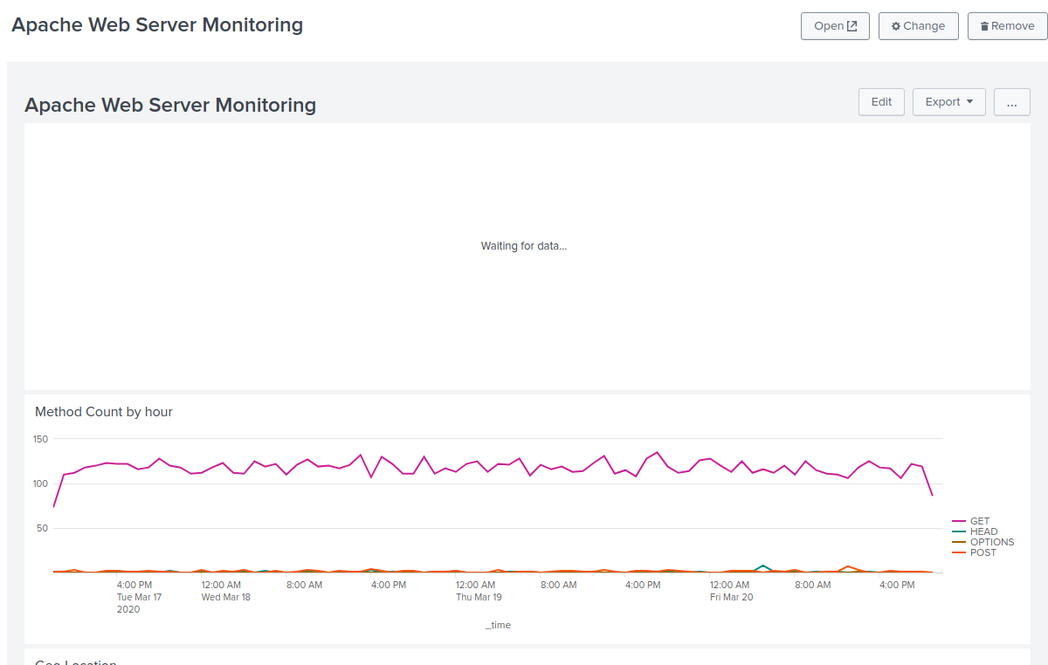
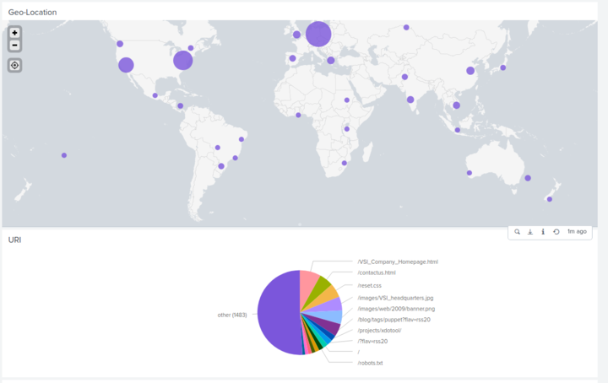
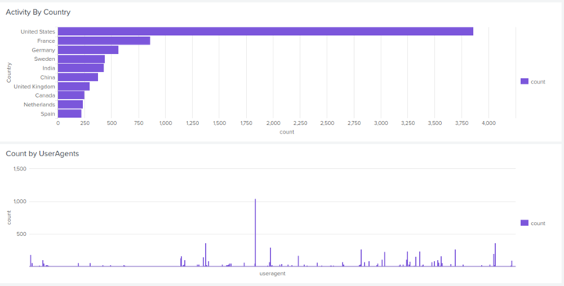
Dashboards—Apache
Place image here
Place image here
Place image here

Slide 27
Attack Analysis
‹#›

Slide 28
Attack Summary—Windows
Summarize your findings from your reports when analyzing the attack logs.
Between the normal logs and the attack logs there was around a 14% increase in high severity levels and a 1.5% increase in successful login attempts.

Slide 29
Attack Summary—Windows
Summarize your findings from your alerts when analyzing the attack logs. Were the thresholds correct?
On Wednesday March 25 2020 at 8:00 am there were 70 failed windows activities with my threshold being set to 15. At the same time and date there were 32 successful logins.

Slide 30
Attack Summary—Windows
Summarize your findings from your dashboards when analyzing the attack logs.
On Wednesday March 25 2020 at 8:00 am user_k and user_a saw an incredible increase in activity. user_a peeked at 984 events whilst user_k peaked around 1256 events

Slide 31
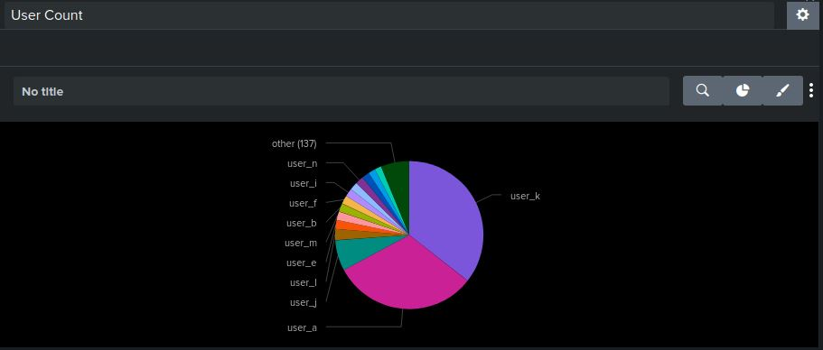
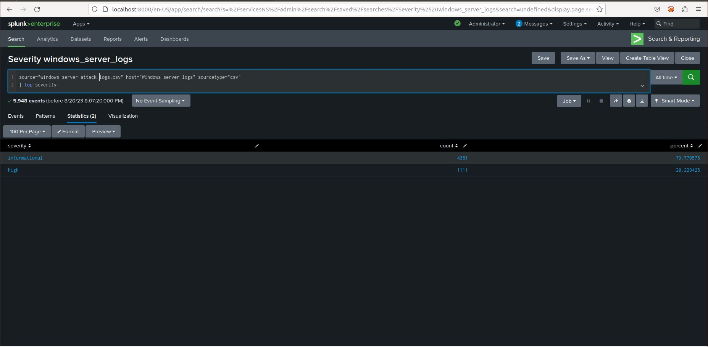
Screenshots of Attack Logs
Before
After

Slide 32
Attack Summary—Apache
Summarize your findings from your reports when analyzing the attack logs.
At 6pm VSI experienced a major attack where reports showed an increase in 404 error codes, they then received an influx of successful HTTP requests in which included more than 1200 POST requests. During this time the most visited URI path was their Account Logon PHP file. It can be assumed that bad actors were attempting a brute force attack.

Slide 33
Attack Summary—Apache
Summarize your findings from your alerts when analyzing the attack logs. Were the thresholds correct?
The alerts set would have sniffed out the massive POST request spike. The foreign activity alert would have picked up on the influx of requests coming from Ukraine.

Slide 34
Attack Summary—Apache
Summarize your findings from your dashboards when analyzing the attack logs.
The visualizations provided on the dashboards gave a lot of insight on where to look. The POST requests and the Status monitor were a good leaping point to investigate all other reports during the spiked time.

Slide 35
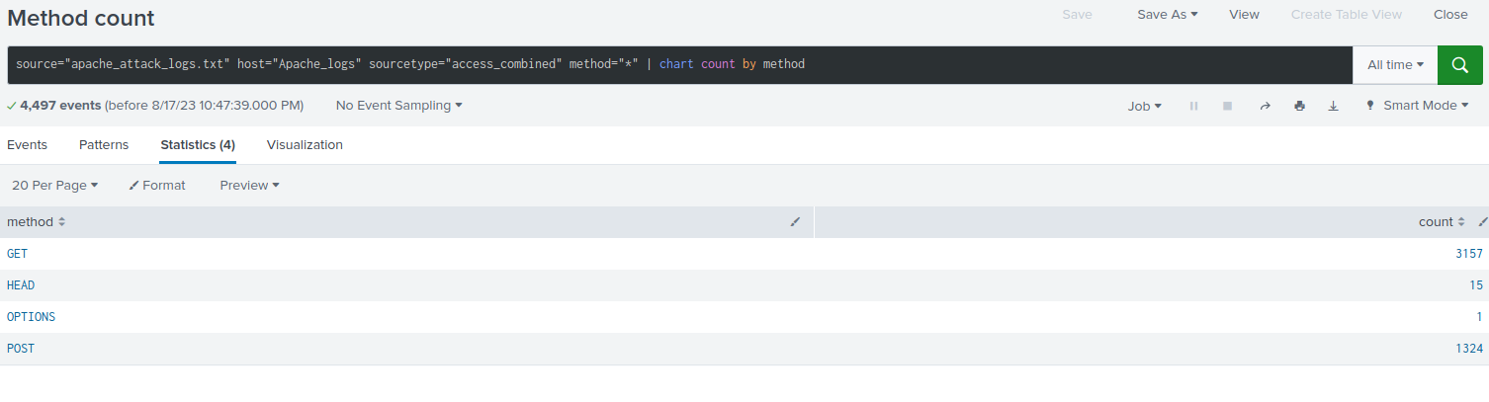
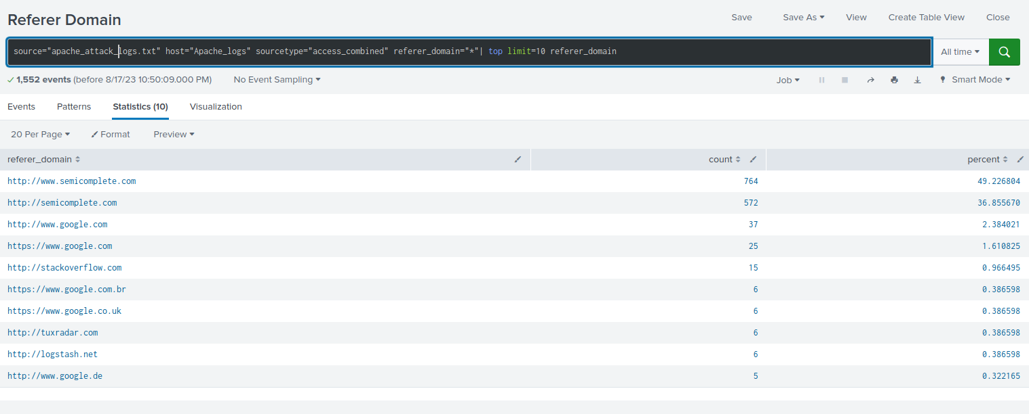
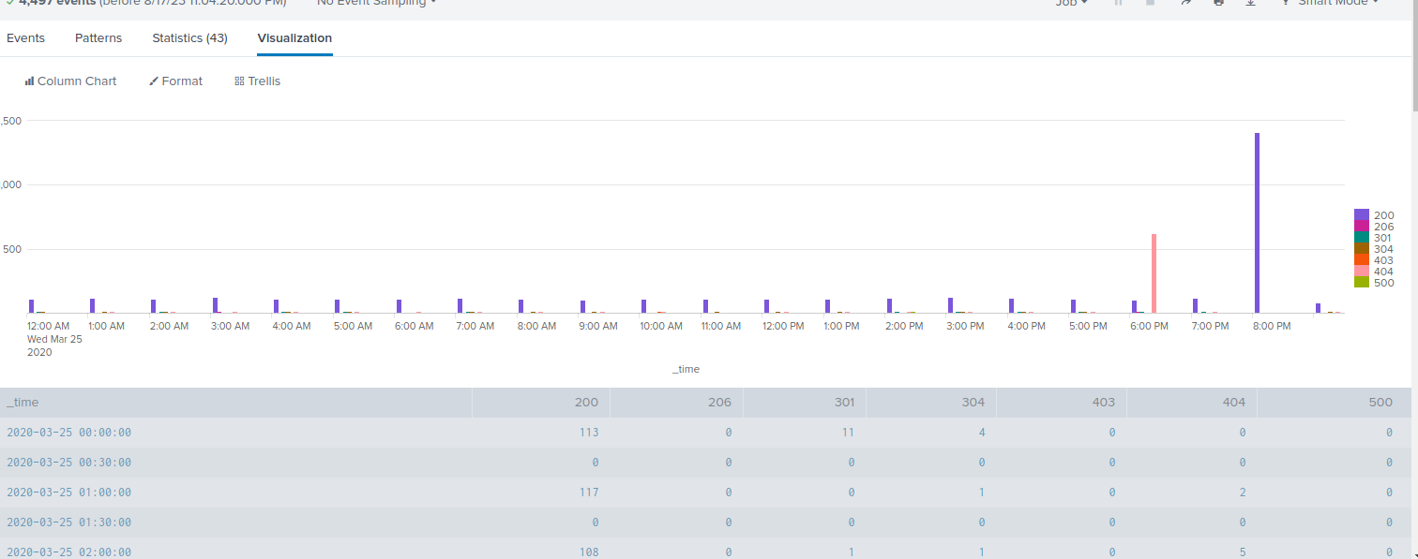
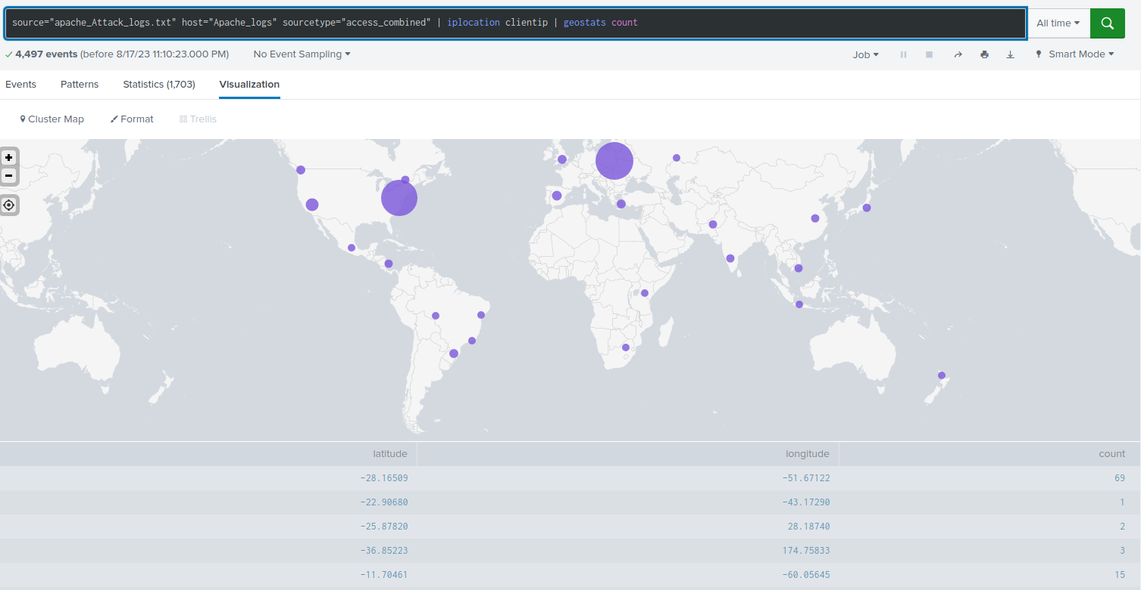
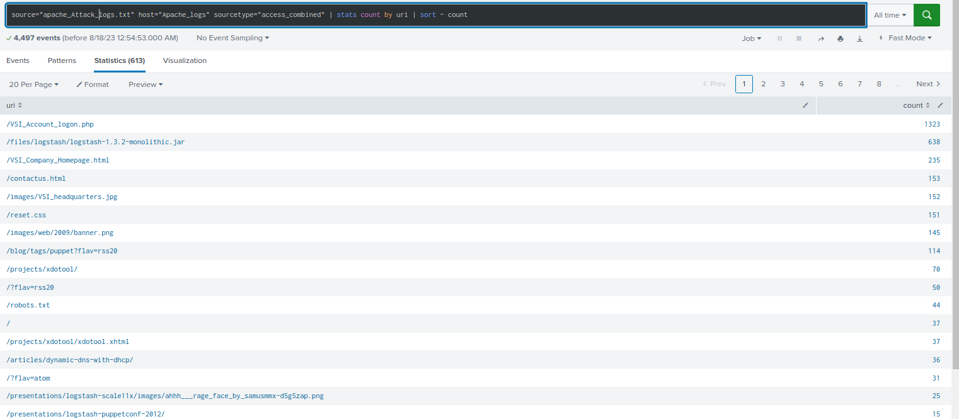
Screenshots of Attack Logs

Slide 36
Summary and Future Mitigations
‹#›

Slide 37
Project 3 Summary
What were your overall findings from the attack that took place?
In the windows logs during the attack we saw a massive increase in brute force login attempts.
During the attack a brute force login attempt was conducted on the Logon.php file seemingly from Kyiv Ukraine using the HTTP POST method.
To protect VSI from future attacks, what future mitigations would you recommend?
Generate more alerts that would depict login attempts and restrict the
number of attempts allowed to deter mass attempts.

